Slide 1


Curriculum Helpful Hints
Office of Academic Planning & Program Development

Slide 2
Academic and Career & Technical
Curriculum Coordinator: Emily Hays
curriculum@SHSU.EDU
(936)294-2427

Slide 3
Common Acronyms
APPD: Academic Planning and Program Development
UCC: University Curriculum Committee
DCC/CCC: Department/College Curriculum Committee
TSUS: Texas State University System
BOR: TSUS Board of Regents

Slide 4
Types of Curriculum & Associated Forms

Slide 5
Academic Curriculum
Division of Academic Affairs
College of Arts and Media
College of Business Administration
College of Criminal Justice
College of Education
College of Health Sciences
College of Humanities and Social Sciences
SHSU Russell & Glenda Gordy College of Osteopathic Medicine
College of Science and Engineering Technology

Slide 6
New Curriculum
Courses
Addition
Core
Programs
Bachelor’s/Master’s Degree
Doctoral Degree
Certificate
Micro-certificate
Minor
Certification

Slide 7
Curriculum Changes
Courses
Deletions
Changes (Prefix, Number, Title)
Degree Programs
CIP Code
Deletions
Designation
Modality
Off-site Location
Relocation
Semester Credit Hour Change
Title
Double Majors
4+1/3+2
Concentration (Undergraduate) or Track (Graduate)

Slide 8
Career and Technical
Polytechnic College

Slide 9
New Curriculum
Courses
Addition (Local Needs Courses)
Programs
Applied Associate of Science
Applied Associate of Arts
Level I, Level II Certificates
Occupational Skills Award

Slide 10
Curriculum Changes
Courses
Deletions (Local Needs courses)
Programs (AAS, Certificates)
CIP Code
Deletions
Designation
Modality
Off-site Location
Relocation
Semester Credit Hour Change
Title

Slide 11
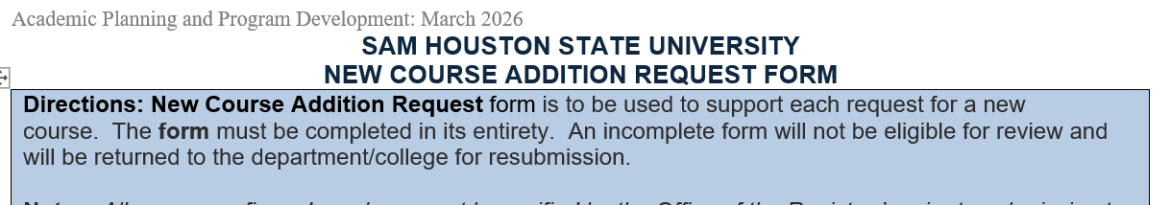
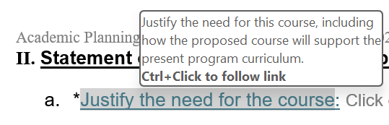

Helpful Form Tools
Course Review Activity
Directions:
Directional Prompts:
Response Tags:

Slide 12
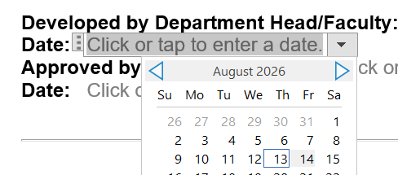
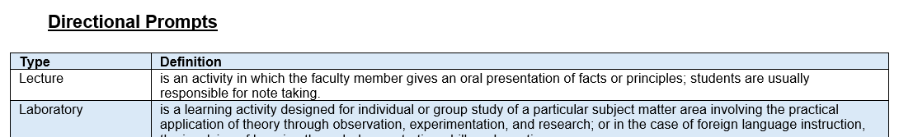
Helpful Form Tools
Course Review Activity
Signature Date:
Listing of Directional Prompts:

Slide 13
Helpful Hints
Forms are updated on a term basis and/or as needed
Updated forms can be found on the APPD Website
Offering Academic Curriculum & C&T Curriculum Office Hours in the Fall
Able to request a pre-liminary review by APPD prior to submission

Slide 14
Curriculum Development & Review Policy

Slide 15
Curriculum Development & Revision Policy (240305)
Academic Affairs Policy
Course Duplication
Interdisciplinary Sign-off
Forms/Submissions

Slide 16
Interdisciplinary Programs
Curriculum Development & Revision Policy (240305)
Proposed Program with three or more courses that are administratively housed within a college outside of the proposing college (excluding core curriculum courses for undergraduate degrees) must be reviewed and recommended for approval by departments and colleges who house it.
Example: A proposed BS in Microbiology creates curriculum with four KINE courses. Proposing College/Department will send the proposal to Department of Kinesiology and COHS for signatures (on the form under Interdisciplinary signatures).

Slide 17
Interdisciplinary Programs
Curriculum Development & Revision Policy (240305)
Proposed Program with at least one course but fewer than three courses that are administratively housed in a college other than the proposing college, the proposing department shall obtain confirmation from the department(s) housing the course(s) that any projected, increased demand can be supported.
Example: BS in Microbiology proposes a program with 2 NURS courses. Initiator of the proposed program will email the School of Nursing to obtain confirmation if the increased demand can be supported.

Slide 18
Course/Program Duplication
Curriculum Development & Revision Policy (240305)
The proposal initiator and department chair should carefully review existing curriculum to ensure there is no unnecessary duplication of content.

Slide 19
Forms and Submissions
Curriculum Development & Revision Policy (240305)
Curriculum submissions at each level (e.g., Department, College, and UCCs) should be submitted using the most current curriculum forms (available on the Academic Planning and Program Development website), be complete with all requested information, and free of significant grammatical or formatting errors.
Incomplete forms or forms containing grammatical or formatting errors that impede review will not be eligible for review that cycle and will be returned to the department/college for resubmission in a later curriculum period.

Slide 20
Curriculum Review

Slide 21
Monthly Curriculum Submissions
September (February BOR)
October (February BOR)
November (May BOR)
January (May BOR)
February (May BOR)
March (August BOR)
April (August BOR)
May (November BOR)
June (November BOR)
July (November BOR)

Slide 22
Monthly Curriculum Submissions
Curriculum submissions due on the first of the month, excluding August and December
Associate/Assistant Dean Representative submits to the UCC Blackboard Organization

Slide 23
Following Blackboard Submission
APPD reviews all submissions
Under AA Policy, any curriculum submission that may impede the review cycle or has incomplete fields will be returned to the College
APPD will meet with Associate/Assistant Dean about the necessary edits
The returned curriculum can be resubmitted for another curriculum entry point

Slide 24
UCC Review
SHSU Approval
There are two main components of UCC Review
Consent Agenda: Proposed changes to current existing courses in the SHSU inventory (Ex: Course Prefix/Number/Title Changes)
Share Document: Complied document of the submitted new curriculum proposals (Ex: New Courses/Programs)
UCC will provide their review via comments on the share document
UCC Associate/Assistant Dean Representative will reach out to the Initiators and/or Department to provide answers to the UCC comments

Slide 25
Share Document Comments
SHSU Approval
At the end of the review, an outstanding comment document is created by APPD and sent to UCC with 24 to 48-hour deadline for Dept/College response
If the UCC deems that additional conversation is needed, then a discussion meeting will be held
  Last Tuesday of the Month
The submission will not move forward to vote, if there are any unanswered comments/concerns on the specific proposal

Slide 26
Voting Results & Revisions
SHSU Approval
A UCC voting summary for the month is compiled
Sent to Department/College to alert of the status
Revisions of the proposal
Due two weeks after notification of results
APPD provides the UCC representatives with the APPD signed copies of the proposal
If a curriculum item was approved; then no requested UCC edits are needed
If a curriculum was approved with changes; then all requested UCC edits must be added to move forward

Slide 27
Finance Review
SHSU Approval
When a new degree program is submitted to the UCC:
Finance will start their review and conduct a Pre-liminary Meeting and Finance Delivery Meeting
Following the delivery meeting, if approved, can move to the next step

Slide 28
President & Provost Review & Approval
SHSU Approval
Two routes:
Review & Approve (i.e. Program Additions/Changes)
Notification (i.e. Courses Additions/Changes)

Slide 29
Texas State University System
External Approval
Program & Administrative Changes
Monthly Submission
New Programs with less than 50% new curriculum: TSUS
Monthly Submission
New Programs with more than 50% new curriculum: BOR
Quarterly Submission

Slide 30
THECB
External Approval
Monthly Submissions
New Programs
undergoes a 30-day comment period prior to THECB review

Slide 31
Implementation Flow Chart Following THECB Approval
Texas Higher Education Coordinating Board
Banner
Catalog
Degree Works
Apply Texas or GradCas
The Registrar’s Office
Office of Academic Planning and Program Development
Office of Enrollment Technology
Office of Admissions
The following SHSU entities have been notified, and if applicable, may have additional steps:
SHSU Online, Office of Integrated Marketing Communication, The Graduate School, DADs, Provost’s Support Offices, etc.
2-6 months

Slide 32
Estimated Review Timeline – Subject to Change

Slide 33
Estimated Curriculum Review – Program & Administrative Changes
Program Title, Designation, CIP Code, Semester Credit Hours, Modality, & Deletion; Organization Structure; Core Curriculum; Instructional Changes
Department & College Approvals
Internal Approvals
External Approvals
Catalog Implementation
Proposer(s)
Department Curriculum Committee
Department Chair
College Curriculum Committee
Academic Dean
Academic Planning and Program Development
University Curriculum Committee*
Office of the Provost
President’s Office
Texas State University System
The Texas Higher Education Coordinating Board
Built and implemented into the Catalog Cycle that was approved.
Varies based on Department and/or College
2-6 months
Based on
approved date
2 months

Slide 34
Curriculum Review – Courses
Additions, Changes, & Deletions
Department & College Approvals
Internal Approvals
Registrar’s Office*
Catalog Implementation
Proposer(s)
Department Curriculum Committee
Department Chair
College Curriculum Committee
Academic Dean
Academic Planning and Program Development
University Curriculum Committee
Office of the Provost (Notification)
Built and implemented in the term it was approved
Built and implemented into the Catalog Term/Cycle that was approved.
Varies based on Department and/or College
CA: Same/next term
CC/D: Following Catalog Cycle
2 months
2 months

Slide 35
Curriculum Review – Concentrations or Tracks
4+1/3+2; Double Major; Additions, Changes, & Deletions
Department & College Approvals
Internal Approvals
Registrar’s Office*
Catalog Implementation
Proposer(s)
Department Curriculum Committee
Department Chair
College Curriculum Committee
Academic Dean
Academic Planning and Program Development
Office of the Provost (Notification)
Associated New Course Additions: Built and implemented in the term it was approved
Built and implemented into the Catalog Term/Cycle that was approved.
Varies based on Department and/or College
2 months
Based on
approved date
2 months

Slide 36
Curriculum Review – Certificate
Addition, Changes, Deletions
Department & College Approvals
Internal Approvals
External Approvals
Catalog Implementation
Proposer(s)
Department Curriculum Committee
Department Chair
College Curriculum Committee
Academic Dean
Graduate Dean*
Academic Planning and Program Development
University Curriculum Committee
Office of the Provost
Texas State University System
The Texas Higher Education Coordinating Board
Built and implemented into the Catalog Cycle that was approved.
Varies based on Department and/or College
2-6 months
Based on
approved date
2 months

Slide 37
Curriculum Review – Minors
Additions, Changes, & Deletions
Department & College Approvals
Internal Approvals
Registrar’s Office*
Catalog Implementation
Proposer(s)
Department Curriculum Committee
Department Chair
College Curriculum Committee
Academic Dean
Academic Planning and Program Development
University Curriculum Committee
Office of the Provost (Notification)
Associated New Course Additions: Built and implemented in the term it was approved
Built and implemented into the Catalog Term/Cycle that was approved.
Varies based on Department and/or College
2 months
2 months
Based on
approved date

Slide 38
Curriculum Review – New Degree Program (Less than 50%)
* Only Graduate Certificates undergo Graduate Dean review and approval
Bachelor’s; Master’s
Department & College Approvals
Internal Approvals
External Approvals
Catalog Implementation
Proposer(s)
Department Curriculum Committee
Department Chair
College Curriculum Committee
Academic Dean
Graduate Dean*
Program Analytics
Academic Planning and Program Development
University Curriculum Committee
Office of Budget and Planning
Office of the Provost
Texas State University System
The Texas Higher Education Coordinating Board
30-day commenting period
Built and implemented into the Catalog Cycle that was approved.
Varies based on Department and/or College
3-4 months
3-4 months
Based on
approved date

Slide 39
Curriculum Review – New Degree Program (More than 50%)
* Only Graduate Certificates undergo Graduate Dean review and approval
Bachelor’s; Master’s
Department & College Approvals
Internal Approvals
External Approvals
Catalog Implementation
Proposer(s)
Department Curriculum Committee
Department Chair
College Curriculum Committee
Academic Dean
Graduate Dean*
Program Analytics
Academic Planning and Program Development
University Curriculum Committee
Office of Budget and Planning
Office of the Provost
Texas State University System Board of Regents
The Texas Higher Education Coordinating Board
30-day commenting period
Built and implemented into the Catalog Cycle that was approved.
Varies based on Department and/or College
3-4 months
6-7 months
Based on
approved date

Slide 40
Curriculum Questions?
Reach out to curriculum@shsu.edu
Call (936) 294-2427
Book a Meeting

